Slide 1
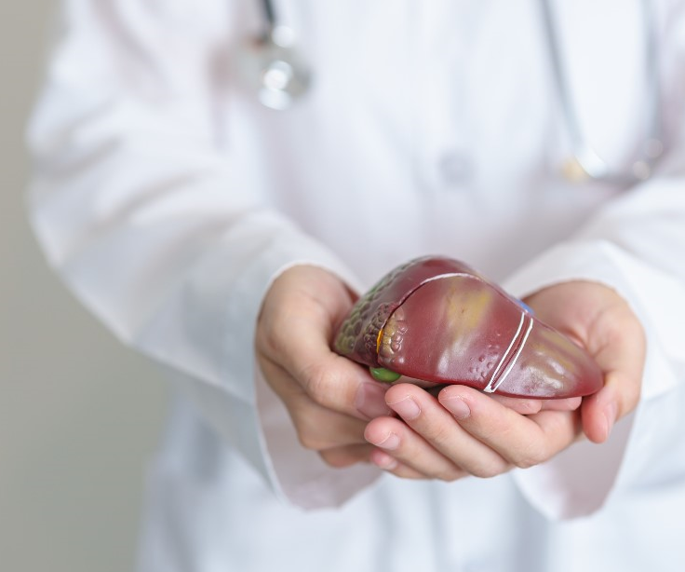

Slide 2
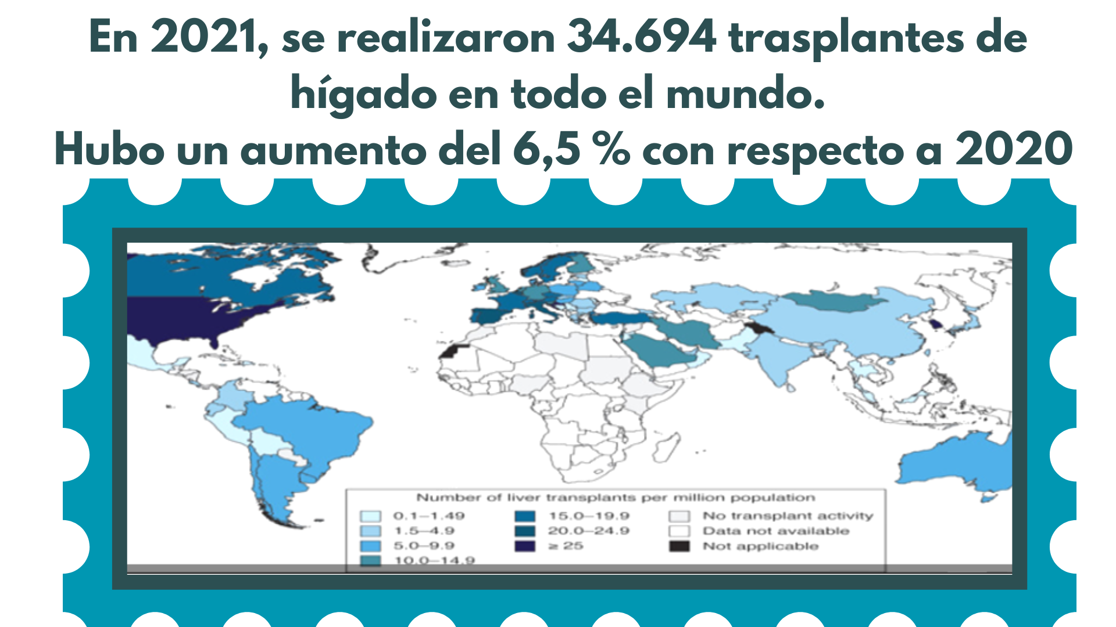
Terrault NA, Francoz C, Berenguer M, Charlton M, Heimbach J. Liver Transplantation 2023: Status Report, Current and Future Challenges. Clin Gastroenterol Hepatol. 2023 Jul;21(8):2150-2166.

Slide 3
Terrault NA, Francoz C, Berenguer M, Charlton M, Heimbach J. Liver Transplantation 2023: Status Report, Current and Future Challenges. Clin Gastroenterol Hepatol. 2023 Jul;21(8):2150-2166.

Slide 4
Puri P, Dhiman RK, Taneja S, Tandon P, Merli M, Anand AC, et al. Nutrition in Chronic Liver Disease: Consensus Statement of the Indian National Association for Study of the Liver. J Clin Exp Hepatol. 2021;11(1):97-143.
European Association for the Study of the Liver. EASL Clinical Practice Guidelines on nutrition in chronic liver disease. J Hepatol. 2019 Jan;70(1):172-193.

Slide 7
Trabajar en equipo multiplica los resultados en todo el proceso del cuidado nutricional.

Slide 11
Bischoff SC, Bernal W, Dasarathy S, Merli M, Plank LD, Schütz T, Plauth M. ESPEN practical guideline: Clinical nutrition in liver disease. Clin Nutr. 2020 Dec;39(12):3533-3562.
Bischoff SC, Bernal W, Dasarathy S, et al. ESPEN Practical Guideline: clinical nutrition in liver disease. Nutrición Hospitalaria. 2022 Mar;39(2):434-472.

Slide 12
Bischoff SC, Bernal W, Dasarathy S, Merli M, Plank LD, Schütz T, Plauth M. ESPEN practical guideline: Clinical nutrition in liver disease. Clin Nutr. 2020 Dec;39(12):3533-3562.
Bischoff SC, Bernal W, Dasarathy S, et al. ESPEN Practical Guideline: clinical nutrition in liver disease. Nutrición Hospitalaria. 2022 Mar;39(2):434-472

Slide 15
Bischoff SC, Bernal W, Dasarathy S, et al. ESPEN Practical Guideline: clinical nutrition in liver disease. Nutrición Hospitalaria. 2022 Mar;39(2):434-472.
Puri P, Dhiman RK, Taneja S, Tandon P, Merli M, Anand AC, et al. Nutrition in Chronic Liver Disease: Consensus Statement of the Indian National Association for Study of the Liver. J Clin Exp Hepatol. 2021;11(1):97-143.
Bischoff SC, Bernal W, Dasarathy S, Merli M, Plank LD, Schütz T, Plauth M. ESPEN practical guideline: Clinical nutrition in liver disease. Clin Nutr. 2020 Dec;39(12):3533-3562.

Slide 16
Bischoff SC, Bernal W, Dasarathy S, Merli M, Plank LD, Schütz T, Plauth M. ESPEN practical guideline: Clinical nutrition in liver disease. Clin Nutr. 2020 Dec;39(12):3533-3562.
Bischoff SC, Bernal W, Dasarathy S, et al. ESPEN Practical Guideline: clinical nutrition in liver disease. Nutrición Hospitalaria. 2022 Mar;39(2):434-472.
Puri P, Dhiman RK, Taneja S, Tandon P, Merli M, Anand AC, et al. Nutrition in Chronic Liver Disease: Consensus Statement of the Indian National Association for Study of the Liver. J Clin Exp Hepatol. 2021;11(1):97-143.

Slide 18
Gracias a la donación son posibles
las segundas oportunidades

